Slide 1
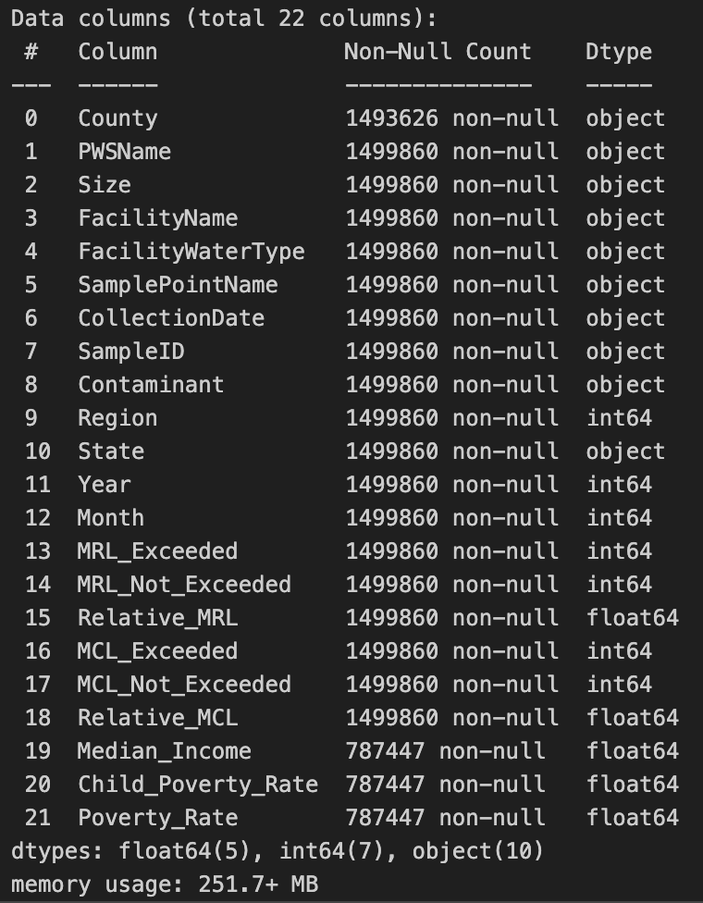
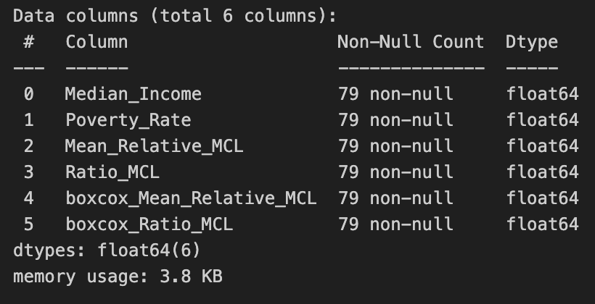


Filter for year 2023 samples only
Aggregation by county
Compute of mean relative MCL (number of MCL thresholds exceeding the MCL for the average sample) and ratio MCL (samples exceeding MCL / all samples)
Remove rows containing NAN (9 missing poverty rate entries)
Filter for counties with Ratio_MCL > 5% (consider only counties with distinct contamination)
Perform BOXCOX-transformation of response variables
Remove outliers (7 rows)

